Slide 1
Economics 144 Economic Forecasting
Lecture 8
Characterizing Cycles
Autoregressive Models
Dr. Randall R. Rojas

Slide 2
Today’s Class
Cycles
Autoregressive (AR) Models
The AR(1) Process
The AR(2) Process
The AR(p) Process
Chain Rule for Forecasting
R Example

Slide 3
Cycles 1 of 3
Def: Cycle = Time series pattern of periodic fluctuations.
Deterministic: Common in engineering, physical sciences, etc. Example: Y_{t} = 2 cos(0.5t+0.8)+ε_{t}
Stochastic: Common in economics, business, etc. Example: Y_{t} = 0.5Y_{t-1} + 0.3Y_{t-2} +ε_{t}

Slide 4
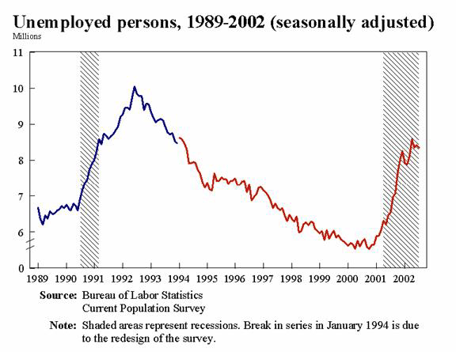
Cycles 2 of 3
Deterministic
Y_{t} = 2 cos(0.5t+0.8)+ε_{t}
Stochastic
Y_{t} = 0.5Y_{t-1} + 0.3Y_{t-2} +ε_{t}

Slide 5
Cycles 3 of 3
B
A
D
C

Slide 6

Autoregressive Models
Def: AR(p) = Autoregressive process of order p≥0: Y_{t} = c +ϕ₁ Y_{t-1} + ϕ₂ Y_{t-2} + …+ϕ_{q} Y_{t-p} +ε_{t}, where , and ϕ = persistence parameter.
Examples:
AR(1): Y_{t} = c +ϕ₁ Y_{t-1} + ε_{t}
AR(2): Y_{t} = c +ϕ₁ Y_{t-1} + ϕ₂Y_{t-2}+ ε_{t}
AR(6): Y_{t} = c +ϕ₆Y_{t-6}+ ε_{t}

Slide 7
Autoregressive Models
For every AR(p) process, we need to address the following 3 questions:
What does a time series of an AR process look like?
What do the corresponding ACFs and PACFs look like?
What is the optimal forecast?

Slide 8
Autoregressive Models Example: AR(1) Process
(1) What does a time series of an AR process look like?
Consider the following AR(1) process:
Y_{t} = c +ϕ Y_{t-1} + ε_{t}
We can plot this process for c =1, and different values of ϕ, e.g., for ϕ=0.4, ϕ=0.7, ϕ=0.95, and ϕ=1.
We can show that E(Y_{t})=c+ϕμ, and σ²(Y_{t}) = σ²_{ε} / (1-ϕ²)
Note: Since E(Y_{t})=μ → μ =c+ϕμ → μ = c/(1-ϕ )
Notes:
Miu is the unconditional mean for the AR model

Slide 9
AR(1): Y_{t} = c +ϕY_{t-1} + ε_{t}
ϕ=0.4
ϕ=0.7
ϕ=0.95
ϕ=1
Notes:
The higher the theta, the less times the line will cross the mean

Slide 10
Autoregressive Models Example: AR(1) Process
(2) What do the corresponding ACFs and PACFs look like?
ACF:
We would expect to see that ρ₁ = p₁ = ϕ, and all others decay to zero according to ρ_{k}= ϕ^{k}.
PACF:
We would expect to see only 1 spike different from zero, i.e., p₁ = ϕ, and all others equal to zero (p_{k}=0, k>1).
Notes:
Phi the persistence, which means how long are the autocorrelation of the lags to stay high

Slide 11
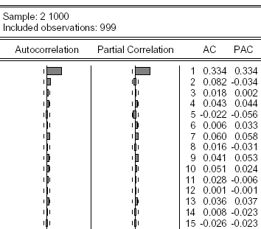
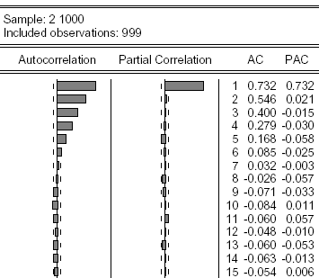
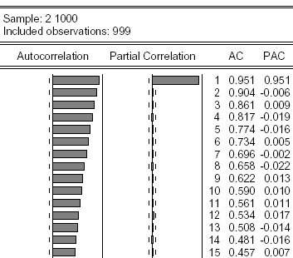

Autocorrelation Functions of Simulated AR(1) Processes
Small persistence
→faster decay to 0
Y_{t} = c +ϕY_{t-1} + ε_{t}
Large persistence
→slower decay to 0
For all three cases

Slide 12
Autoregressive Models Example: AR(1) Process
A useful Property for AR Processes:
A necessary and sufficient condition for an AR(1) process Y_{t} = c +ϕY_{t-1} + ε_{t} to be covariance stationary is that |ϕ|<1.

Slide 13
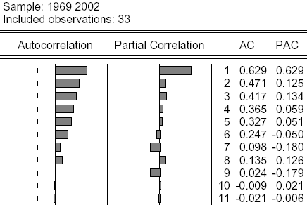

Autoregressive Models Example: AR(1) Process
Q: Does this series look like an AR(1) process?
A: Yes, since ρ₁ = p₁ = ϕ and ρ_{k} →0 for k>1.

Slide 14
Autoregressive Models Forecasting in an AR(1) Process
Consider first the 1-step-ahead forecast, h = 1:
AR(1): Y_{t} = c +ϕY_{t-1} + ε_{t} → Y_{t+1} = c +ϕY_{t} + ε_{t+1}
Optimal Point Forecast: f_{t,1} = E(Y_{t+1}|I_{t}) = c +ϕY_{t}
One-period-ahead Forecast Error: e_{t,1} = Y_{t+1} - f_{t,1}= ε_{t+1}
Uncertainty of the Forecast: σ²_{t+1|t} = var(Y_{t+1}|I_{t}) = σ²_{ε}
Density Forecast: f(Y_{t+1}|I_{t}) ~ N(c +ϕY_{t} , σ²_{ε} )
Note: We can compute the confidence intervals from the density forecast.
Please go over the steps for h=1 and h=2 (Section 7.2ª)
Notes:
It is the information set

Slide 15
Autoregressive Models Forecasting in an AR(1) Process
Consider the k-step-ahead forecast, h = k for the
AR(1): Y_{t} = c +ϕY_{t-1} + ε_{t} process:
Optimal Point Forecast: f_{t,k} = E(Y_{t+k}|I_{t}) = c(1+ϕ+…+ϕ^{k-1}) +ϕ^{k}Y_{t}
k-period-ahead Forecast Error:
e_{t,k} = Y_{t+k} – f_{t,k}=ε_{t+k}+ ϕε_{t+k-1}+…+ ϕ^{k-1}ε_{t+1}
Uncertainty of the Forecast:
σ²_{t+k|t} = var(Y_{t+k}|I_{t}) = σ²_{ε}(1+ϕ²+ϕ⁴+…+ϕ^{2(k-1)})
Density Forecast: f(Y_{t+k}|I_{t}) ~ N(μ_{t+k|t} , σ²_{t+k|t} )
Note: We can compute the confidence intervals from the density forecast.

Slide 16
Autoregressive Models Forecasting in an AR(1) Process
Recall that for covariance-stationary processes, |ϕ|<1 and ϕ^{k} →0 for large values of k (k→∞). Therefore, the optimal forecast does not depend on the information set, and thus has a ‘short-term memory’.
f_{t,k} = c(1+ϕ+ϕ²+…) = c/(1-ϕ)
σ²_{t+1|t} = σ²_{ε}(1+ϕ²+ϕ⁴+…) = = σ²_{ε} /(1-ϕ²)

Slide 17

Autoregressive Models Example: AR(2) Process
Example: Y_{t} = c +ϕ₁ Y_{t-1} + ϕ₂ Y_{t-2} +ε_{t}
A useful Property for an AR(2) Process:
The necessary conditions for an AR(2) process to be covariance stationary are that -1<ϕ₂<1 and -2<ϕ₁<2,
and the sufficient conditions are that ϕ₁+ϕ₂<1 and ϕ₂-ϕ₁<1.
Note: For an AR(2) the respective unconditional mean is given by:

Slide 18
Autoregressive Models Example: AR(2) Process
Q: Is this process stationary?
A: No since ϕ₁+ϕ₂=1
Y_{t} = 1 +0.5Y_{t-1} +0.5Y_{t-2} +ε_{t}
Notes:
If the coefficients do not add up, that means that although it is an AR process, it is not sstationary

Slide 19
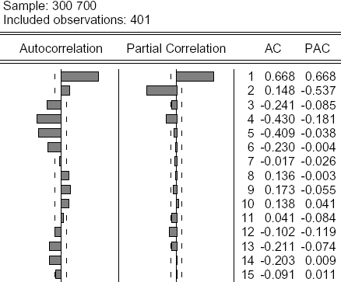
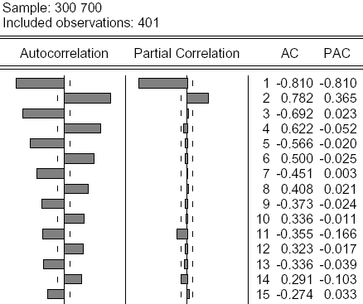
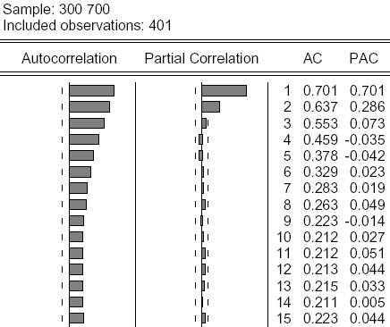
Autoregressive Models Example: AR(2) Process
All three AR(2) Processes have in common:
ρ₁ = p_{1,} p₂ = ϕ₂, and p₁≠0 and p₂≠0, all other p_{k} =0 (k>2)
Notes:
If both the coefficients are 0.5 and -0.5, the acf will have the same length

Slide 20
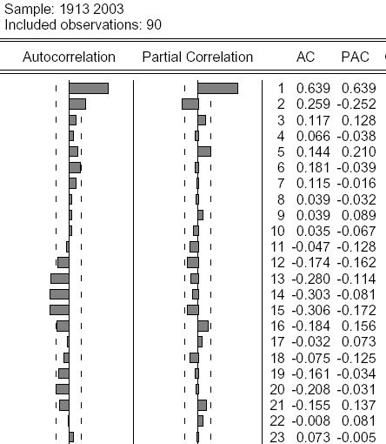
Autoregressive Models Example: AR(2) Process
1913-2003 Inflation Rate
Q: What model would you suggest?
A: An AR(2) with ϕ = -0.25
Notes:
If the line does not cross the mean often, we can model it with an AR process. Looking at the PACF to determine the specific AR

Slide 21
Multistep Forecast of the U.S. Inflation Rate

Slide 22
Autoregressive Models Example: AR(2) Process

Slide 23
Autoregressive Models AR(P) Process
In general, for an AR(p) process:
Y_{t} = c +ϕ₁Y_{t-1} +ϕ₂Y_{t-1} +… +ϕ_{p}Y_{t-p}+ ε_{t}
We can show that
ρ₁ = p_{1,}
The speed of the ACF’s decay depends on the persistence of ϕ₁+ϕ₂+… +ϕ_{p}
p₁≠0, p₂≠0, …p_{p}≠0, and p_{p}=0 for k>p

Slide 24
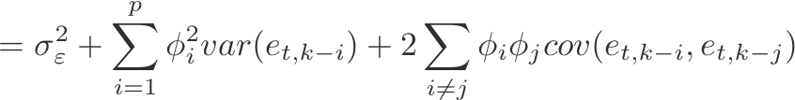
Autoregressive Models Forecasting in an AR(p) Process
Consider the k-step-ahead forecast, h = k for the AR(p): Y_{t} = c +ϕ₁Y_{t-1} +ϕ₂Y_{t-2} +… +ϕ_{p}Y_{t-p}+ ε_{t} process:
Optimal Point Forecast:
f_{t,k} = E(Y_{t+k}|I_{t}) = c+ϕ₁f_{t,k-1}+…+ϕ_{p}f_{t,k-p}
k-period-ahead Forecast Error:
e_{t,k} = Y_{t+k} – f_{t,k}=ε_{t+k}+ ϕ₁e_{t,k-1}+…+ ϕ_{p}e_{t,k-p}
Uncertainty of the Forecast:
σ²_{t+1|t}
Density Forecast: f(Y_{t+k}|I_{t}) ~ N(μ_{t+k|t} , σ²_{t+k|t} )

Slide 25
Autoregressive Models Forecasting in an AR(p) Process
Chain Rule for Forecasting
Y_{t} = c +ϕ₁Y_{t-1} +ϕ₂Y_{t-2} +… +ϕ_{p}Y_{t-p}+ ε_{t}
Step1 (change t→t+1): Compute f_{t,1} = Y_{t+1}
f_{t,1} = c +ϕ₁Y_{t} +ϕ₂Y_{t-1} +… +ϕ_{p}Y_{t+1-p}
Step2 (repeat Step 1): Compute f_{t,2}
f_{t,2} = c +ϕ₁Y_{t+1} +ϕ₂Y_{t} +… +ϕ_{p}Y_{t+2-p}
= c + f_{t,1} + ϕ₂Y_{t} +… +ϕ_{p}Y_{t+2-p}
…
f_{t,k} = c+ f_{t,k-1} + ϕ₂ f_{t,k-2} +… +ϕ_{p} f_{t,k-p}

Slide 26
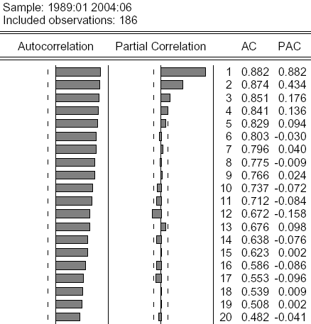
Moving Average Models Example: AR(p) Process
Q: What type of a process is this?
AR(4)
In general, for any AR(p) process, p_{k} = 0 for any k>p.

Slide 27
For Next Class
Readings about today’s class:
Chapter 7ª, 8^{b}
Review Exercises / Problems:
Chapter 8^{b}: 1, 2
Chapter 8^{b}: 2, 3, 4, 9
Readings for next class:
Chapter 7ª (Section 7.3), Chapter 9^{b}

